Slide 1

IMS Starter project
Charles HErrIott

Slide 2
Introduction
Hi, my name is Charlie Herriott.
My approach:
My first step was break down the specification into smaller logical steps.
For example, ‘Add a customer to the system’. I took this requirement and broke it down into the steps that I would take to accomplish this task.
I would need to be able to: create an object in Java, pass that object through an SQL query, add it to the database and then read the row back from the database, including the primary key.

Slide 3
I considered the structure in which I would approach the project. This meant including Jira and GitHub in my work approach. I adhered to this flow:
I create a user story which describes the end goal and reason behind it
I implemented functionality to complete this task
I then committed the implementation through a feature branch into my GitHub repository

Slide 4
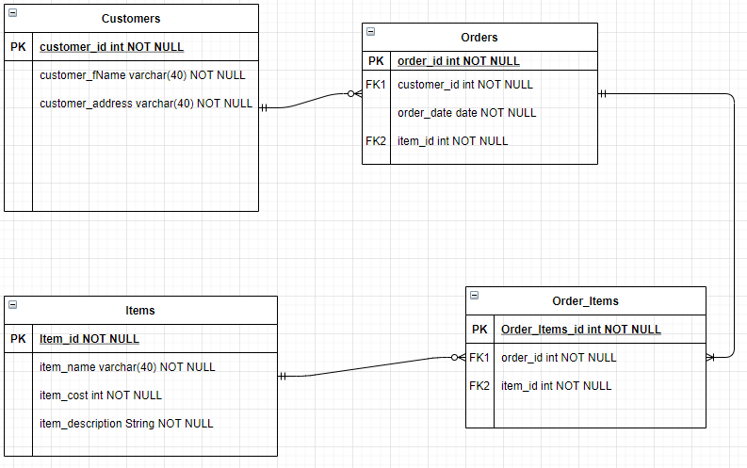
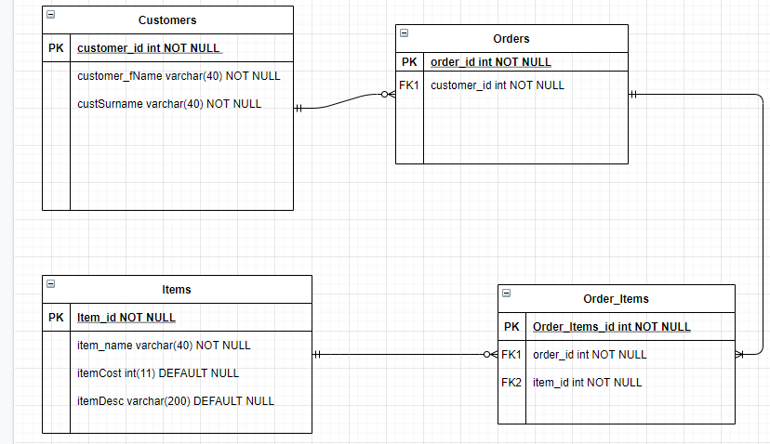

Slide 5
Continuous Integration

Slide 6
Testing

Slide 7
Demonstration

Slide 8
Sprint review

Slide 9
Sprint retrospective

Slide 10
conclusion

Slide 11
questions

